Slide 1
1/21/2024
DEUTERONOMY 30:19
0
I
call heaven and earth
to record this day against
you that….
I
have set before YOU….
LIFE and DEATH
BLESSING and CURSING
THEREFORE:
CHOOSE LIFE,
that BOTH THOU and
THY SEED
may LIVE!!
DEUTERONOMY 30:19
CHOOSE LIFE !!!

Slide 2
NOT A SERMON….
Just A thought ! ! !
A nation that kills its own
children has no future.
Pope John Paul II
1

Slide 3
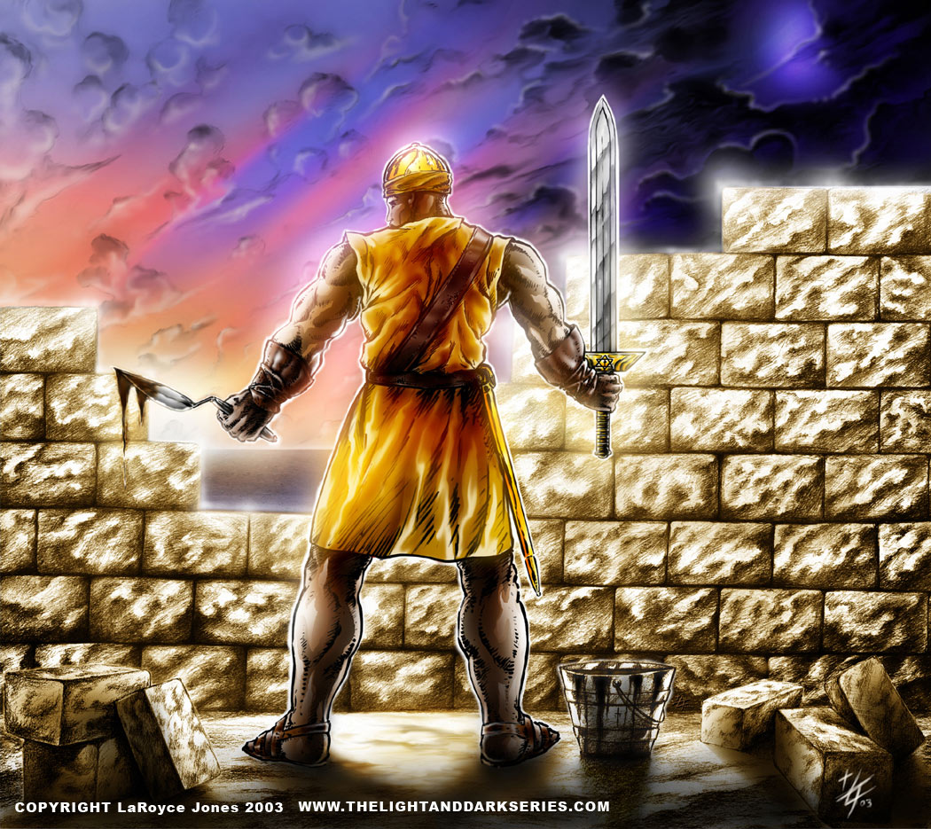
Build & Fight
2
GeN’xt Community
Continuity
Nehemiah 4:17-18 (KJV)
¹⁷They which builded on the wall, and they that bare burdens, with those that laded, every one with one of his hands wrought in the work, and with the other hand held a weapon. ¹⁸For the builders, every one had his sword girded by his side, and so builded. And he that sounded the trumpet was by me.
BUILD to Last
FIGHT TO WIN
NEHEMIAH 4:15-18 (THE MESSAGE)
¹⁵⁻¹⁸ Our enemies learned that we knew all about their plan and that God had frustrated it. And we went back to the wall and went to work. From then on half of my young men worked while the other half stood guard with lances, shields, bows, and mail armor. Military officers served as backup for everyone in Judah who was at work rebuilding the wall. The common laborers held a tool in one hand and a spear in the other. Each of the builders had a sword strapped to his side as he worked. I kept the trumpeter at my side to sound the alert.
Build...To Last!
Fight... To Win!

Slide 4
3
Sermon Notes with Pastor’s Teaching Tool
Nehemiah 1:4-11
THE RESPONSE AND REQUEST! - Pt. 2
⁴ And it came to pass, when I heard these words, that I sat down and wept, and mourned certain days, and fasted, and prayed before the GOD of Heaven,
⁵ And said, I beseech thee, O LORD GOD of HEAVEN....
BUILD TO LAST – FIGHT TO WIN
January 21, 2024

Slide 5
Not A Sermon
Just
A Thought
"As a of the
…
Your Lesson
have and "
WWW
4
Teacher
Word of GOD
MUST
Intent
Content!

Slide 6
Teaching Purpose
Answers the question, “How should I understand this verse?” Is the passage dealing with a:
Sermonic Principle(s)
Answers the Question, “What’s in it, or What’s the take away for me?”
1) The Book of Nehemiah is the classic book in the Bible on the matter
of Personal Service.
2) No SERVICE of any kind can be taken on with so much potential
as Service to THE MASTER
5
S | P | E | C | S
Sin to confess and forsake? | Promise to claim? | Example to follow? | Command to obey? | Situation or State of mind to avoid before it develops into a sin?

Slide 7
Sermonic Principle(s) - cont. 6
3) Service TO HIM can be so/so REWARDING on one hand and
...so/so Disappointing on the other hand
4) Whenever GOD wants to get a major work done HE calls out
a willing SERVANT
5) Never was there a time when men and women of Faith/
Principles/ Conviction/ and Courage are called out
to SERVE THE MASTER than NOW. . . RIGHT NOW!
6) Our GOD...still uses Ordinary People from the servant class in
society to put HIS cause in a place of priority and BUILD /
REBUILD HIS CHURCH upon the SURE FOUNDATION of HIS
WORD!

Slide 8
Sermonic Principle(s) - cont. 7
7) Nehemiah did more than sit down
weep
mourn and
fast... Nehemiah PRAYED!
Nehemiah PRAYED because HE KNEW GOD’S WORD
HE BELIEVED GOD’S WORD
HE RESTED / TRUSTED IN GOD’S
WORD and
HE BELIEVED in the GREAT GOD
of THE WORD!
Nehemiah BELIEVED in a GREAT and GRACIOUS GOD Who
a) KEPT HIS PROMISES
b) FORGAVE the sins of HIS CHILDREN
c) HELPED HIS CHILDREN when they CALLED ON HIM...

Slide 9
Sermonic Principle(s) - cont. 8
10) Nehemiah’s PRAYER was simple and clear...
a) He ACKNOWLEDGED HIS GOD by HIS COVENANT / HIS
RELATIONSHIP name...JEHOVAH (v. 5)
b) He ACKNOWLEDGE HIS GOD as the SUPREME
SOVEREIGN and POWER over ALL...the GOD OF
HEAVEN (v. 5)
c) HE is THE GOD who inspires “AWE”...(a REVERENT /
HEALTHY FEAR)...HE is TERRIBLE (v. 5)
d) HE is a FAITHFUL GOD...Keeping every PROMISE that HE
makes to HIS PEOPLE (v. 5)
e) HE PRAISED GOD for WHO HE is...HIS CHARACTER /
NATURE
f) HE PRAISED GOD for WHAT HE does!

Slide 10
Sermonic Principle(s) - cont. 9
Nehemiah was a Confessor of HIS own sins and an
Intercessor for the sins of his people
Nehemiah approached HIS GOD with an ATTITUDE of
SUBMISSION...he came into the presence of his GREAT
GOD as a SERVANT (v. 6 / v. 11)
Nehemiah made a complete CONFESSION of his sins and the
sins of GOD’S PEOPLE (Israel)
a) They (both) violated the COMMANDMENTS of THE LORD:
- the moral principles by which their LIVES were to be LIVED
b) They (both) violated the STATUTES of THE LORD:
- the rites / rituals / ceremonies of their FAITH
c) They (both) violated the JUDGEMENTS of THE LORD:
- the principles of fairness practiced in their treatment of one
another

Slide 11
10
Having heard and understood this teaching, answers the question, “What should I do?”
LIVE LIKE IT. . .
SERVE LIKE IT!
Action Point

Slide 12
11
Sermon Notes with Pastor’s Teaching Tool
Nehemiah 1:4-11
THE RESPONSE AND REQUEST! - Pt. 2
⁴ And it came to pass, when I heard these words, that I sat down and wept, and mourned certain days, and fasted, and prayed before the GOD of Heaven,
⁵ And said, I beseech thee, O LORD GOD of HEAVEN....
BUILD TO LAST – FIGHT TO WIN
January 21, 2024

Slide 13
Build & Fight
12
GeN’xt Community
Continuity
Nehemiah 4:17-18 (KJV)
¹⁷They which builded on the wall, and they that bare burdens, with those that laded, every one with one of his hands wrought in the work, and with the other hand held a weapon. ¹⁸For the builders, every one had his sword girded by his side, and so builded. And he that sounded the trumpet was by me.
BUILD to Last
FIGHT TO WIN
NEHEMIAH 4:15-18 (THE MESSAGE)
¹⁵⁻¹⁸ Our enemies learned that we knew all about their plan and that God had frustrated it. And we went back to the wall and went to work. From then on half of my young men worked while the other half stood guard with lances, shields, bows, and mail armor. Military officers served as backup for everyone in Judah who was at work rebuilding the wall. The common laborers held a tool in one hand and a spear in the other. Each of the builders had a sword strapped to his side as he worked. I kept the trumpeter at my side to sound the alert.
Build...To Last!
Fight... To Win!

